Slide 1

EDA Netflix and Disney+: Understanding trends and insights
Group 7 – Robert Franklin, Trang Nguyen
November 2022

Slide 2
Table of contents
01 | Project description | 3
02 | Our approach | 9
03 | Our findings | 15
04 | Limitations | 22

Slide 3
Project Description
01

Slide 4
Project Description
Recently Disney+ has overtaken Netflix in streaming subscriptions, reaching 221 million subscribers by August 2022. This project aims to understand prevailing trends and insights in streaming contents released during the COVID-19 pandemic (November 2019 and November 2021) by both platforms
Key insights:
How many shows are being released during the period?
Has Netflix / Disney+ uploaded more TV Shows or Movies?
What release years - new release or older release shows or movies?
Which countries are the movies & shows coming from?
What is the month/year added pattern?
What are the most popular directors/actors?

Slide 5
Our Approach
02

Slide 6
Approach
01
Identify data sources
02
Define strategy
03
Data cleaning and manipulation
04
Data visualisation and reporting
03
Kaggle, API, government data portals, UCI Machine Learning repositories
Create separate Git branches for Netflix & Disney+
Identify key insights that we want to study
Data treatment: null/duplicated values, data types, misaligned timeframe
Create new columns to produce graphs as required
Produce graphs to answer all questions in interest

Slide 7
Our Findings
03

Slide 8
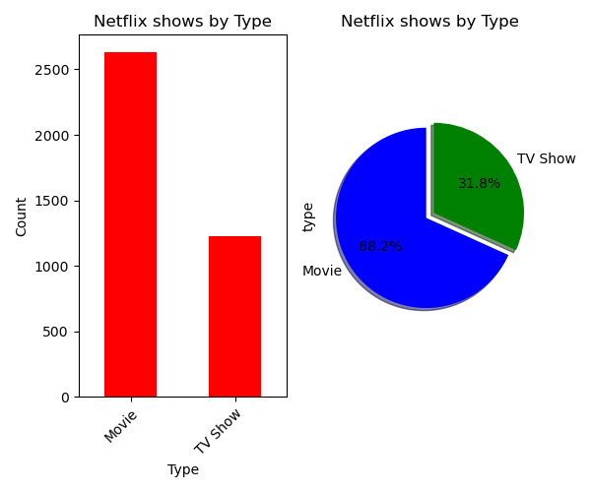
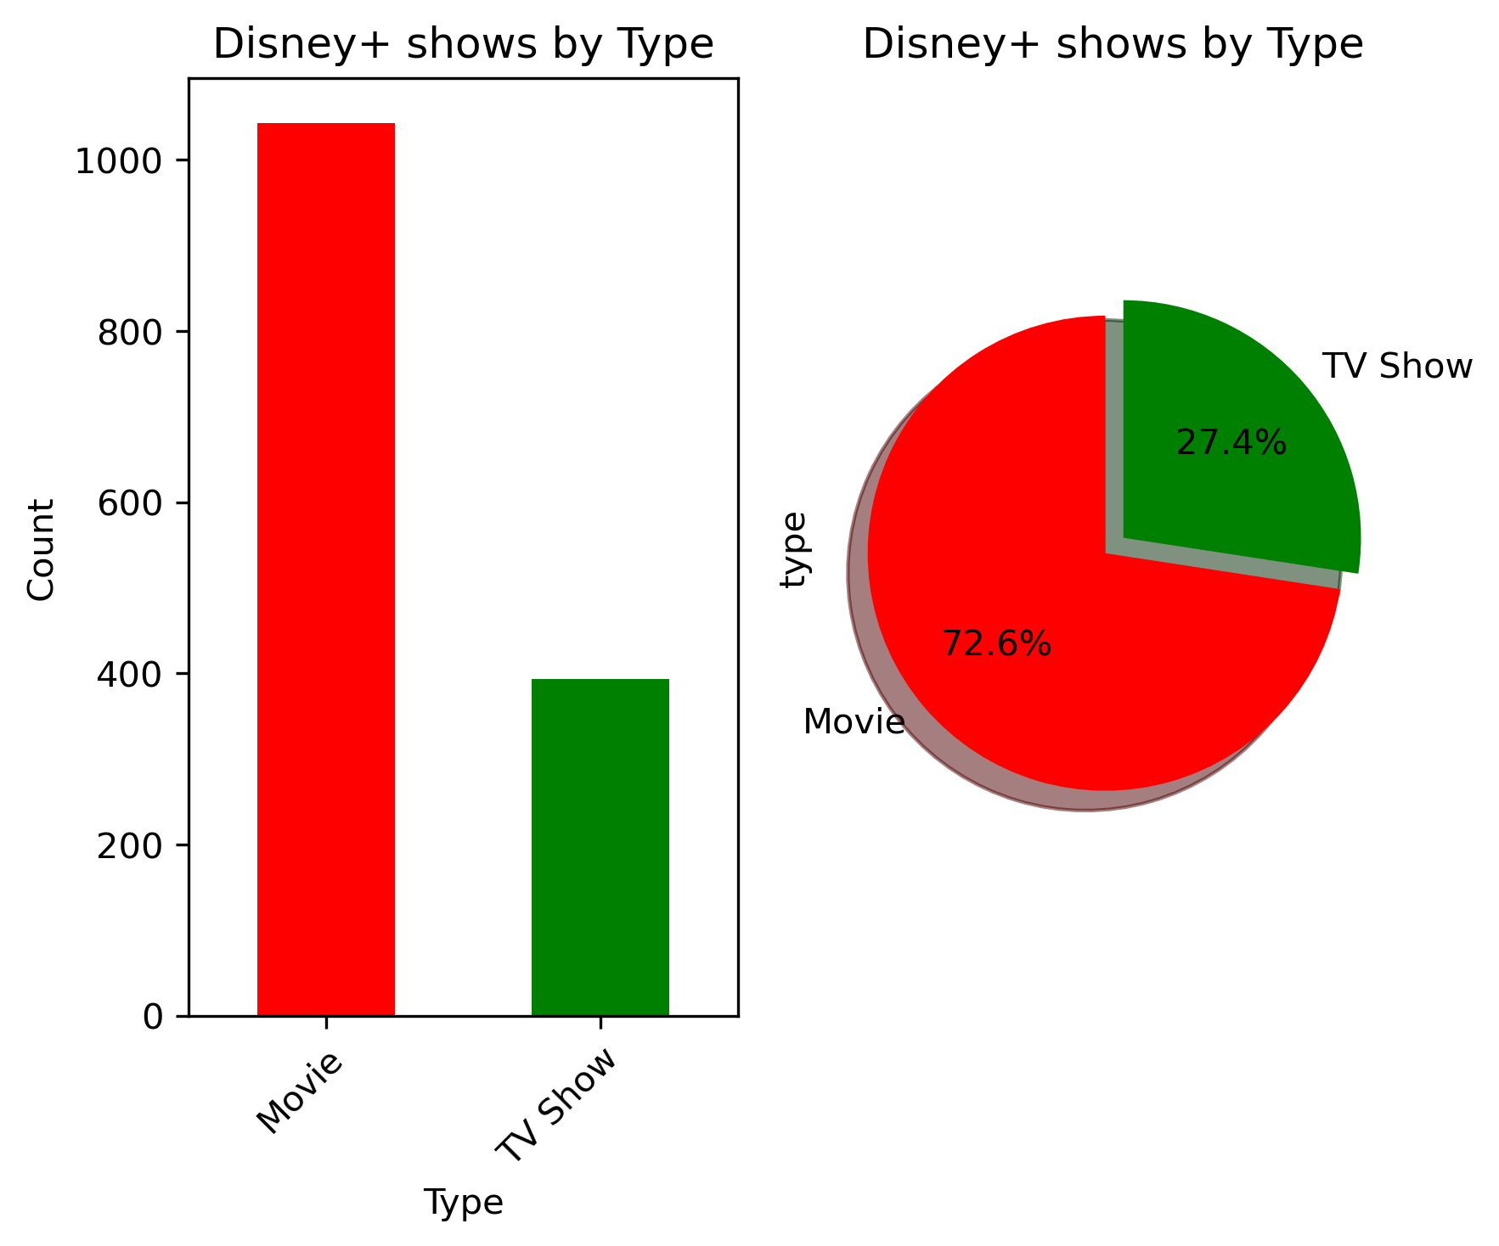
Type of content
Over the same period, Netflix added more than 2,500 movies and ~1,200 TV show. Compared to Netflix, Disney+ added about ~1,000 movies and only 400 TV shows.
In terms of proportion, both platforms have quite similar split of 70:30 for Movie/TV show

Slide 9
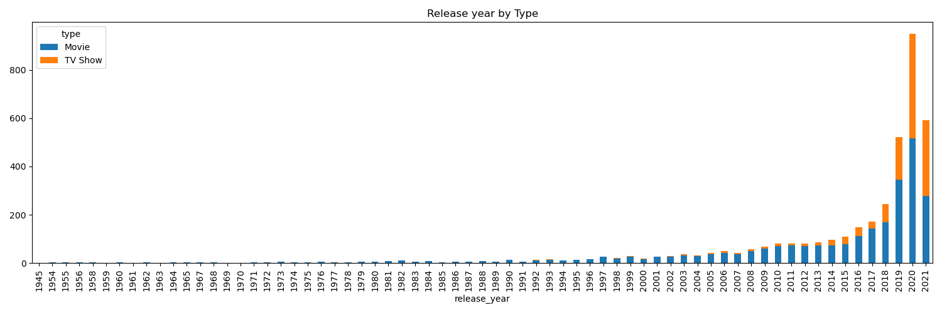
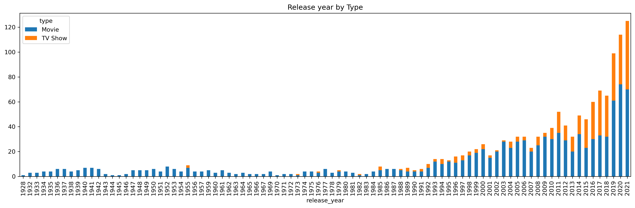
Release year of content
Netflix
Disney+ added content with a wider range of release years due to its longer history of content production.
Netflix has a drop in contents released in 2021 while Disney+ demonstrates a relatively consistent upward trend.
Disney+ has an increase number of TV shows released from 2000s, while Netflix has a more noticeable number of TV shows released from 2015
Disney+

Slide 10
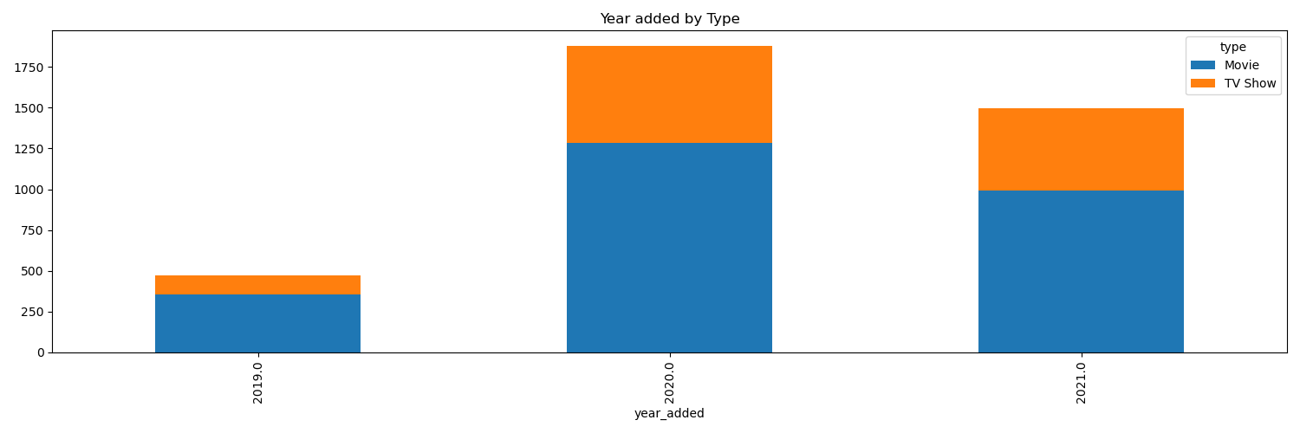
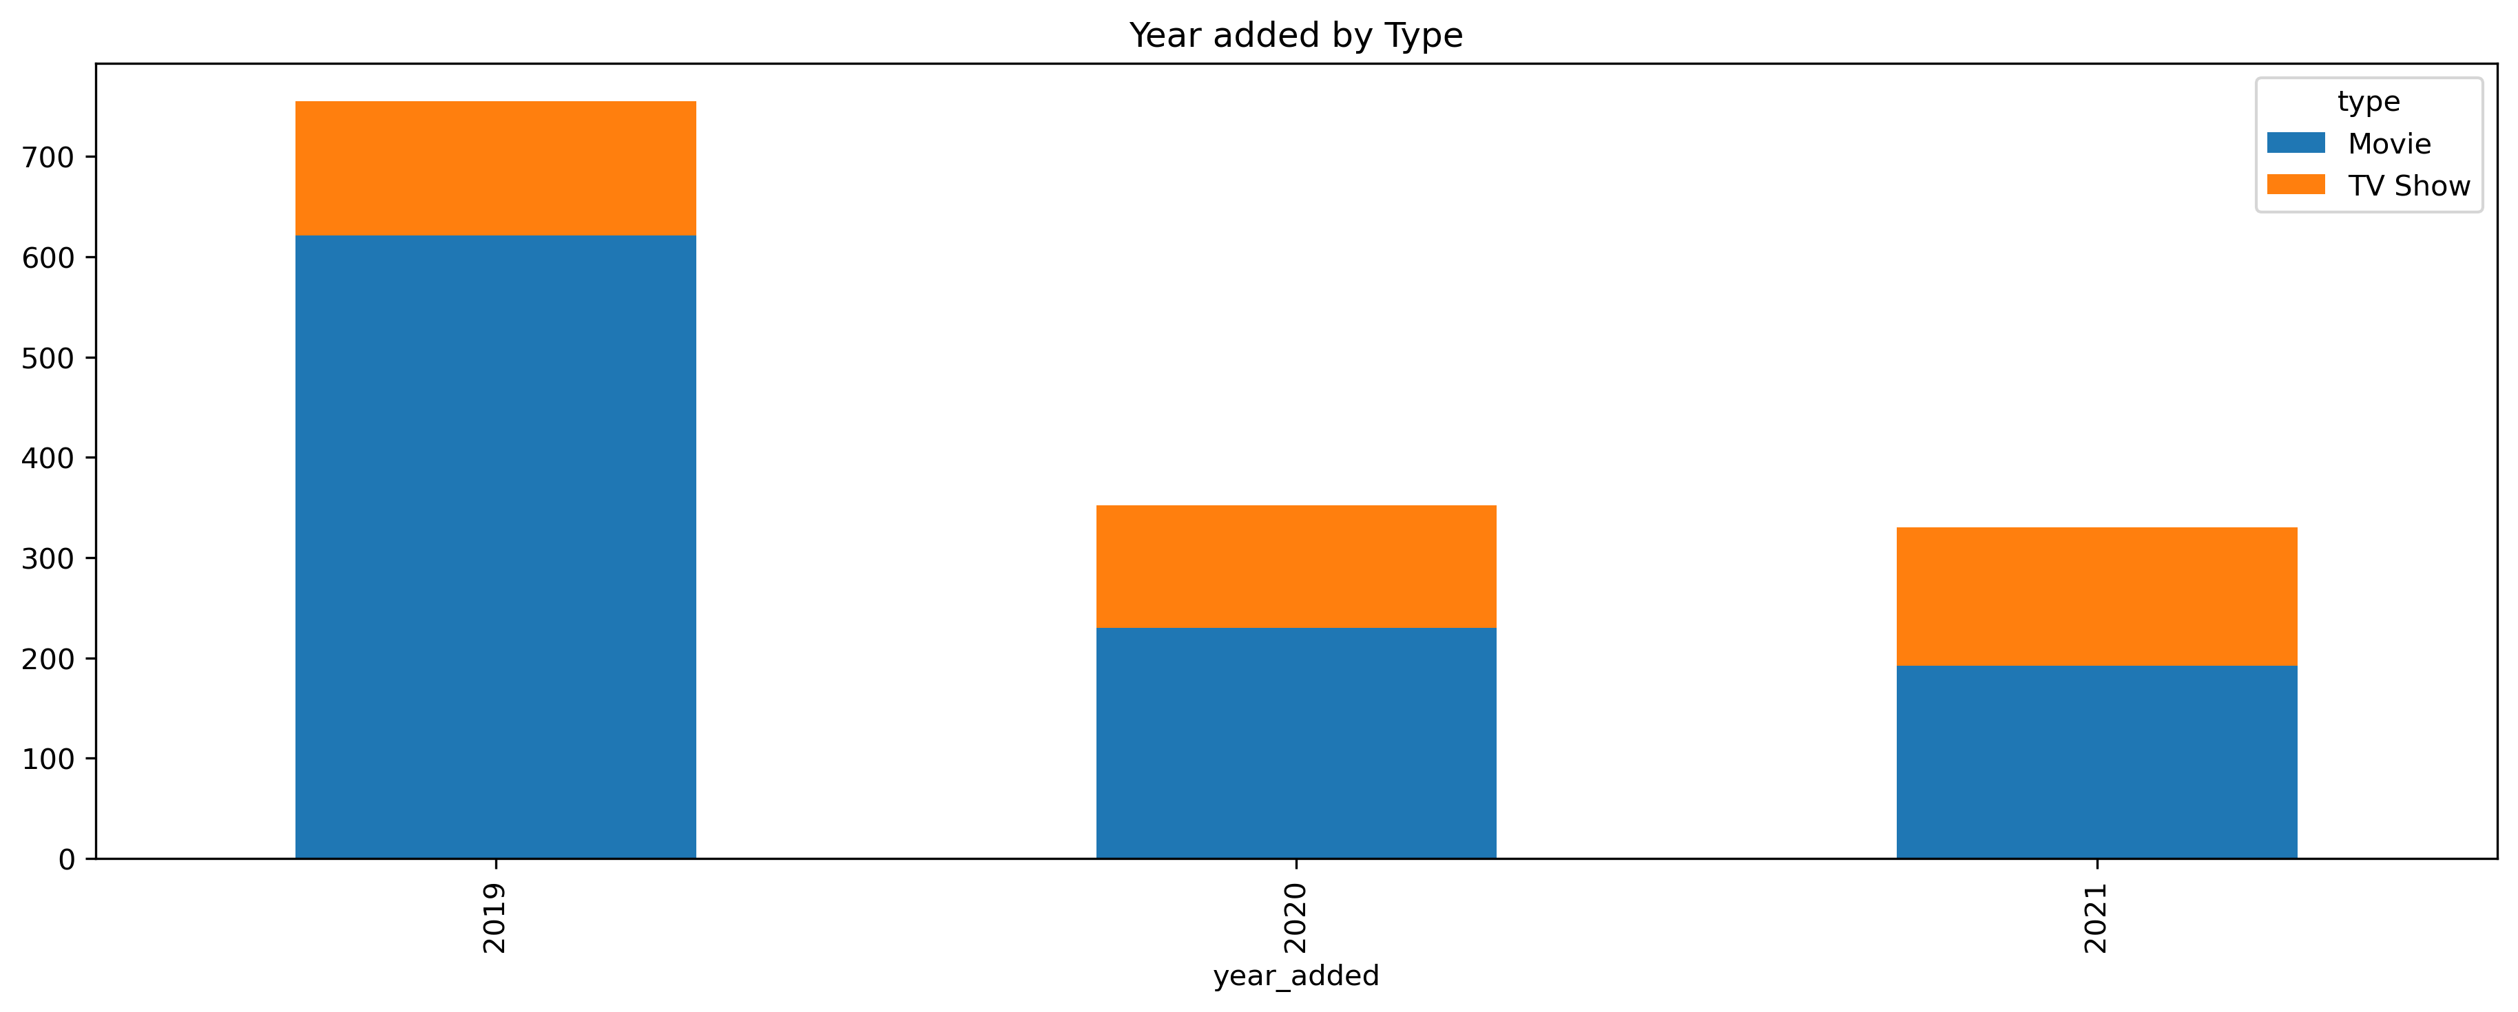
Year added
Netflix
Disney+ has the most contents added in 2019, while it’s an opposite case for Netflix
Netflix has a surge in contents added in 2020 and 2021 while Disney+ shows a drop in those years
Disney+

Slide 11
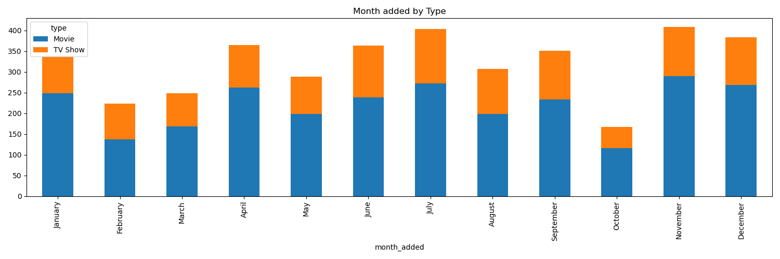
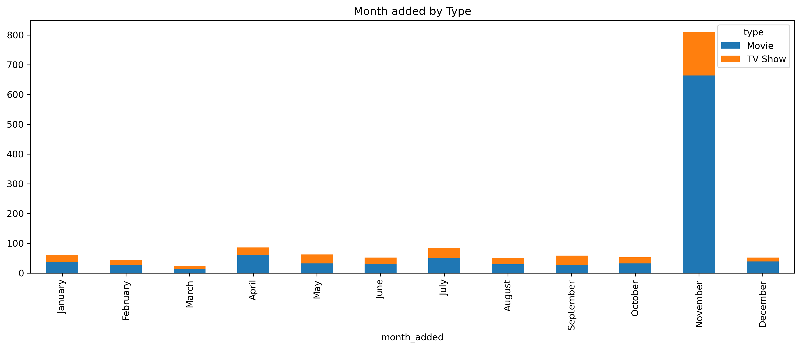
Month added
Netflix
Disney+ has the most contents added in November (Disney+ Day), while Netflix has the most contents added in April, July, September and December (i.e. holiday months)
Disney+

Slide 12
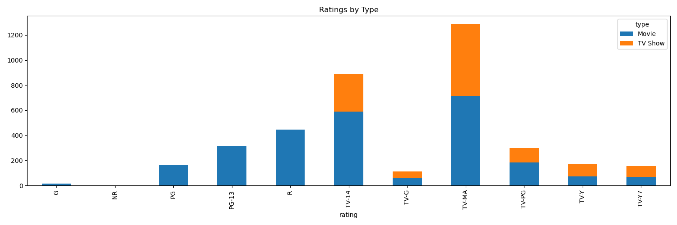
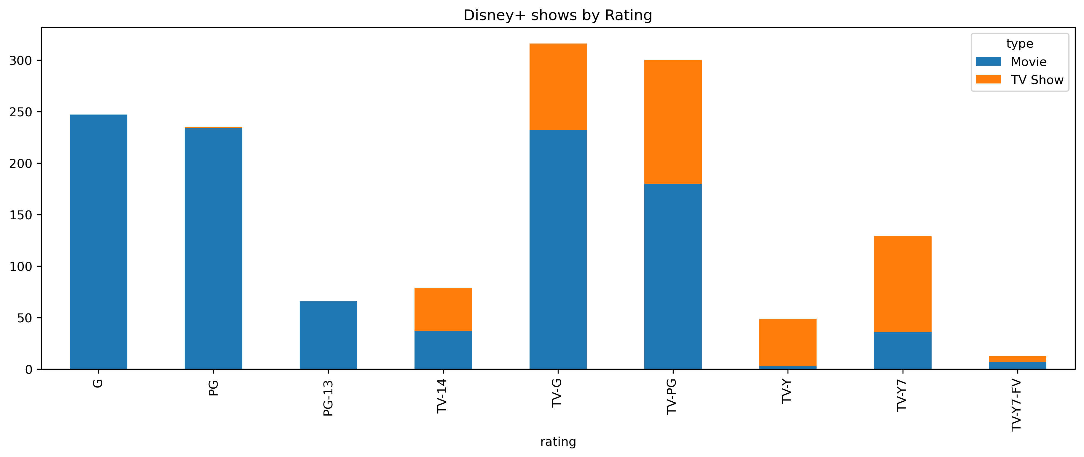
Rating
Netflix
The two platforms have a contrasting pattern in their content ratings
Netflix has the most contents with TV-MA and TV-14 rating, while Disney+ has a small amount of contents with TV-14 rating and none with TV-MA rating
Disney+ has the majority of contents rated as TV-G and TV-PG, while Netflix has a handful of contents with these ratings

Slide 13
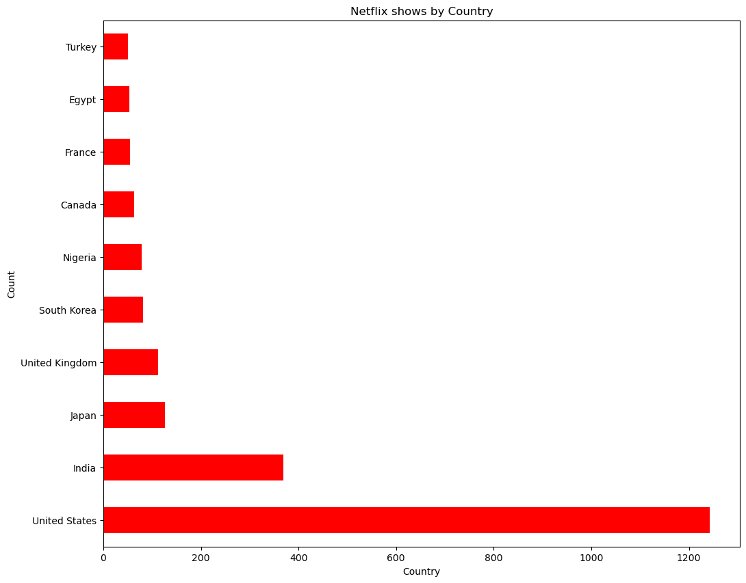
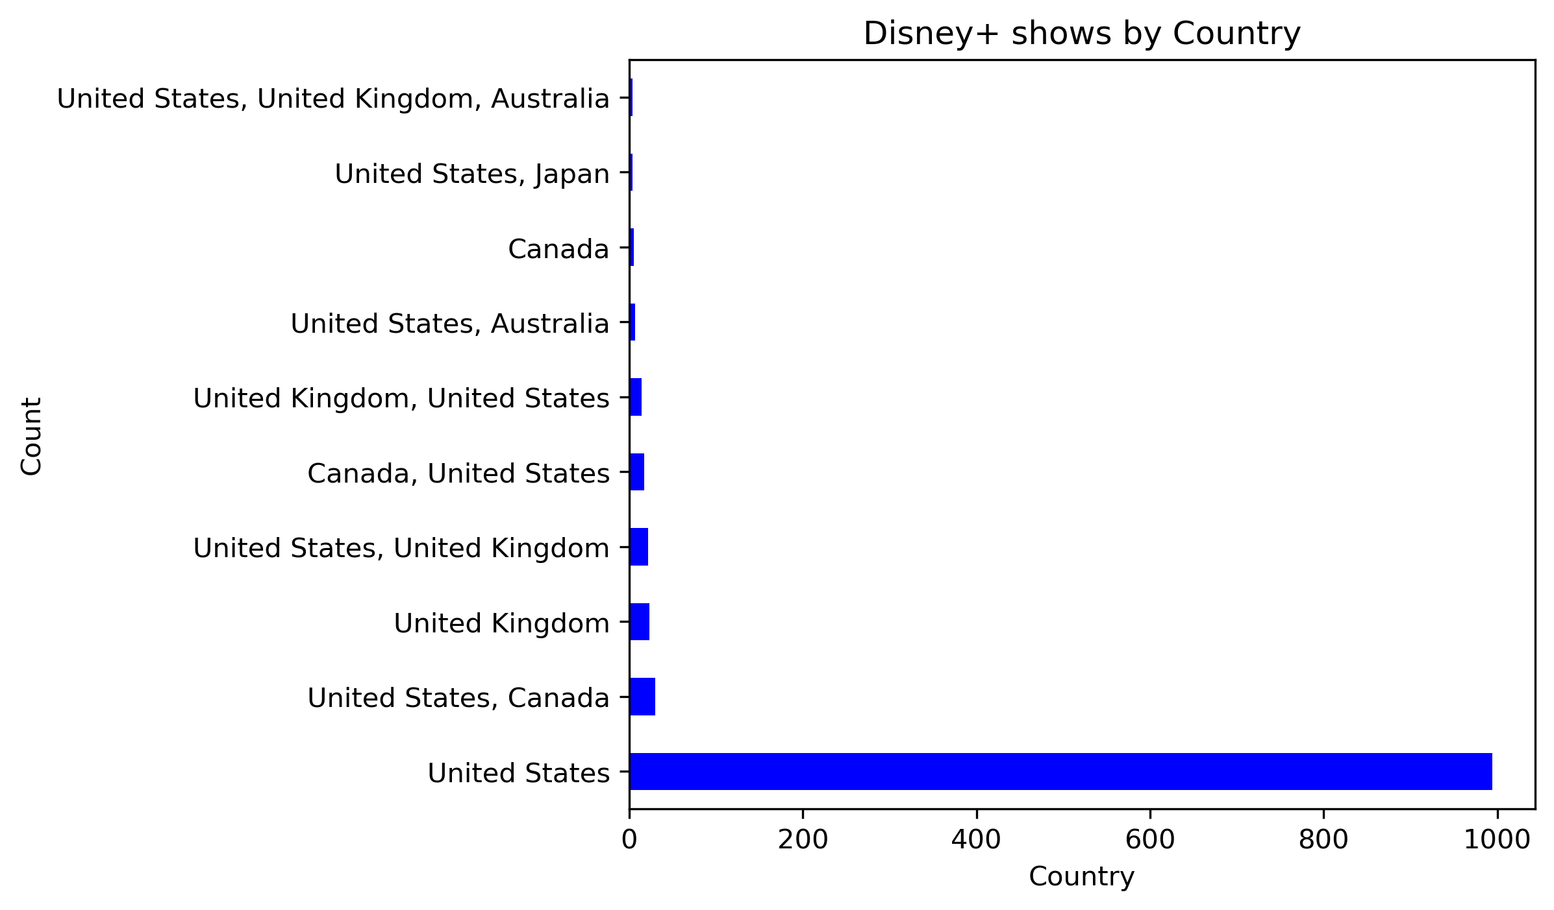
Country
Both platforms have the majority of contents produced in the US.
Netflix has a large amount of contents produced in Asia like India, Japan and South Korea.
Disney+ mainly has contents produced in the US, the UK, Australia and Canada.
Country
Count
Country
Count

Slide 14
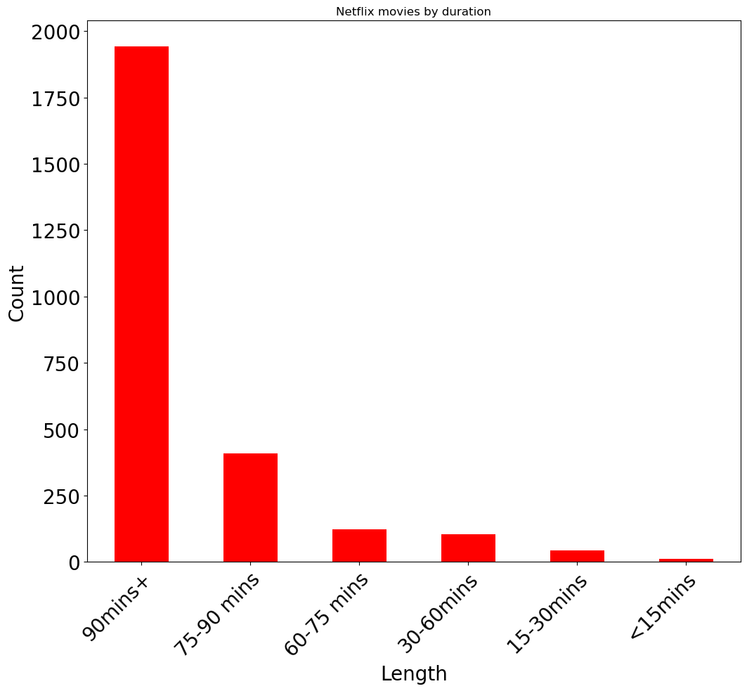
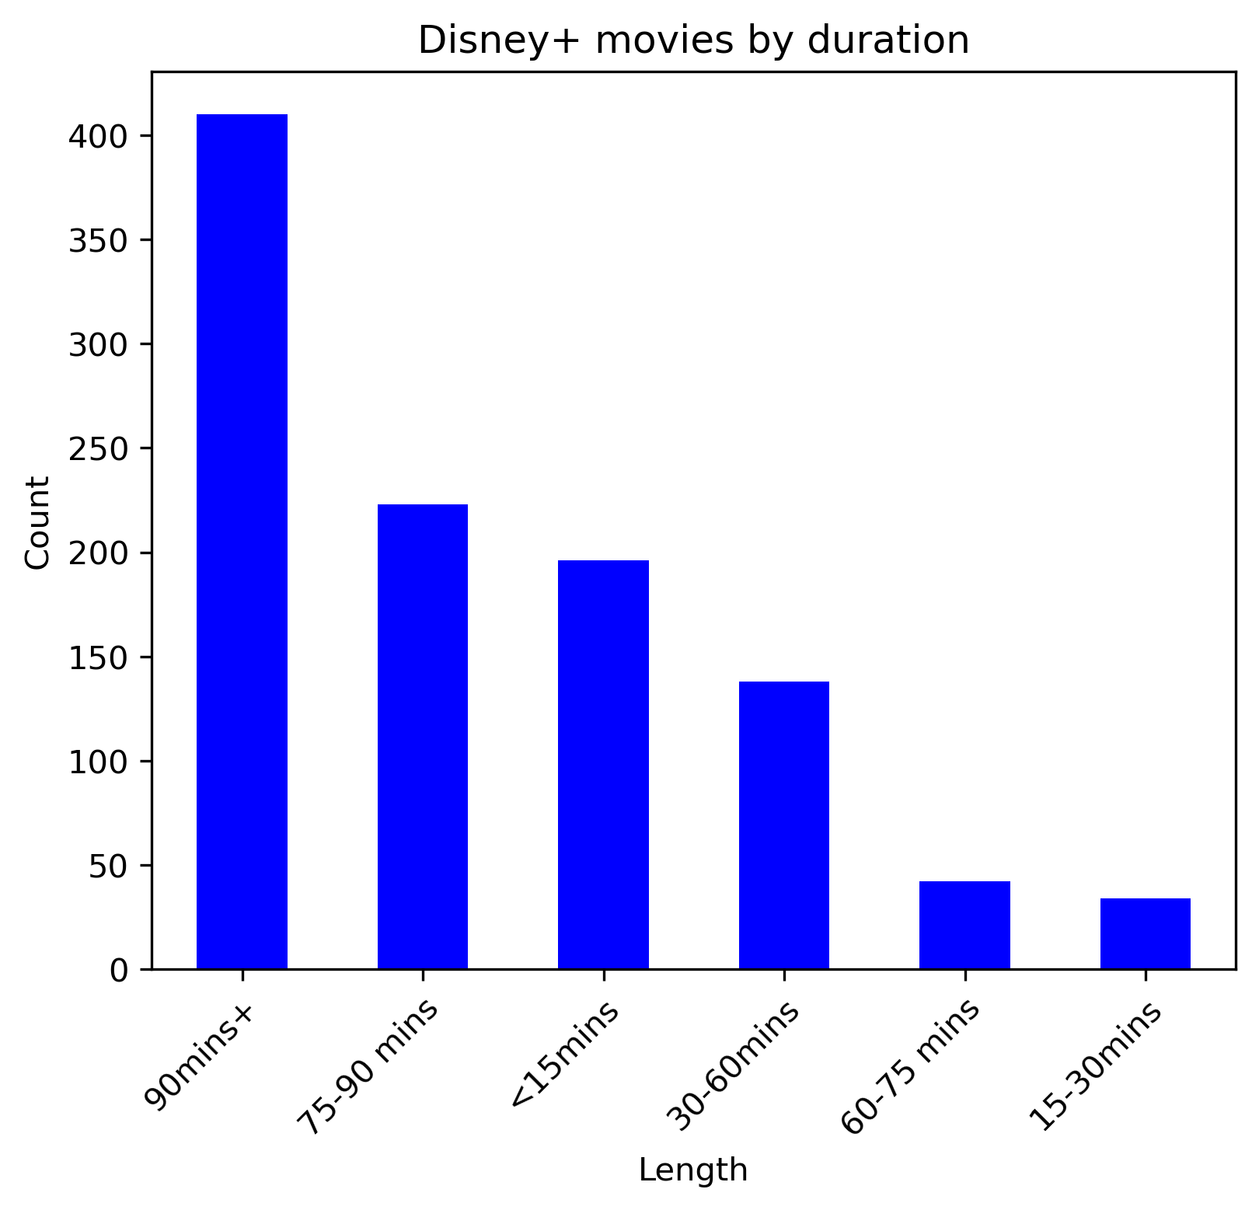
Movie by duration
Disney+ movies vary in durations with some smaller lengthed films, while the majority of Netflix movies are 90+ minutes.
90+ minutes is the most common movie length for both Netflix and Disney+.

Slide 15
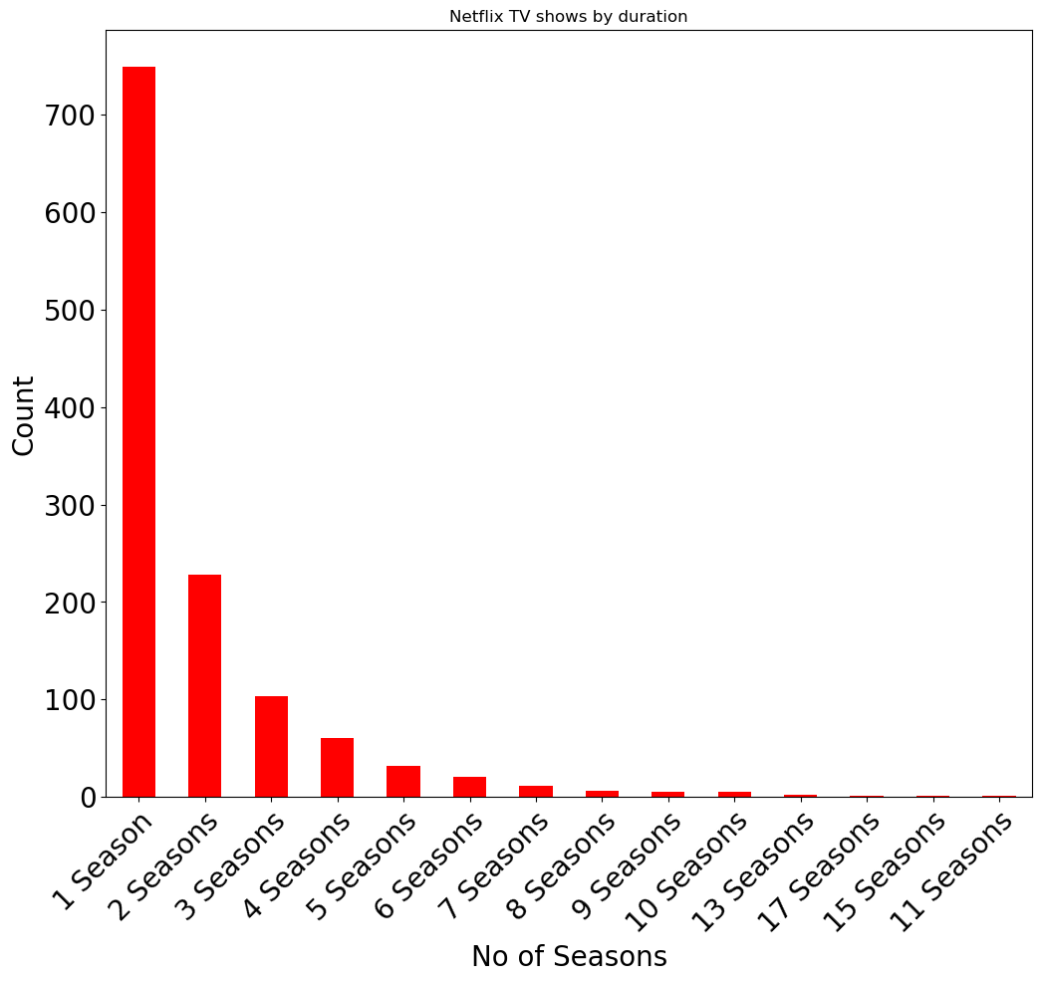
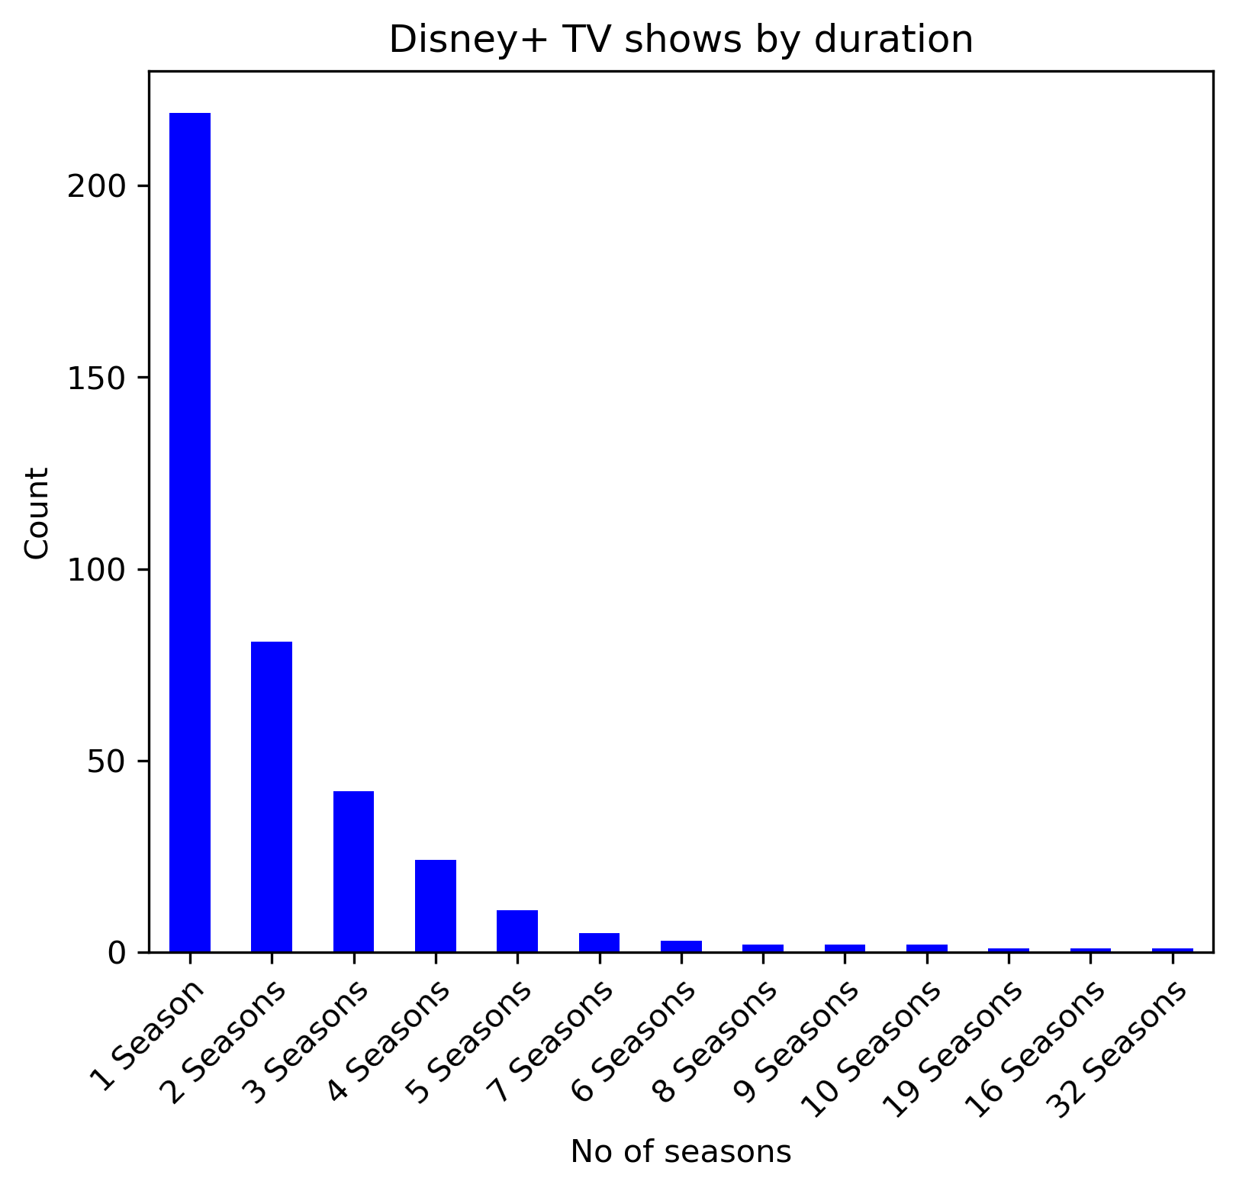
TV Show by duration
Both Netflix and Disney+ have similar TV Show durations distributions, with most shows only having 1 season.
Both streaming platforms have only a small handful of shows with more than 10 seasons. (Disney+ has one TV show with 32 seasons!)

Slide 16
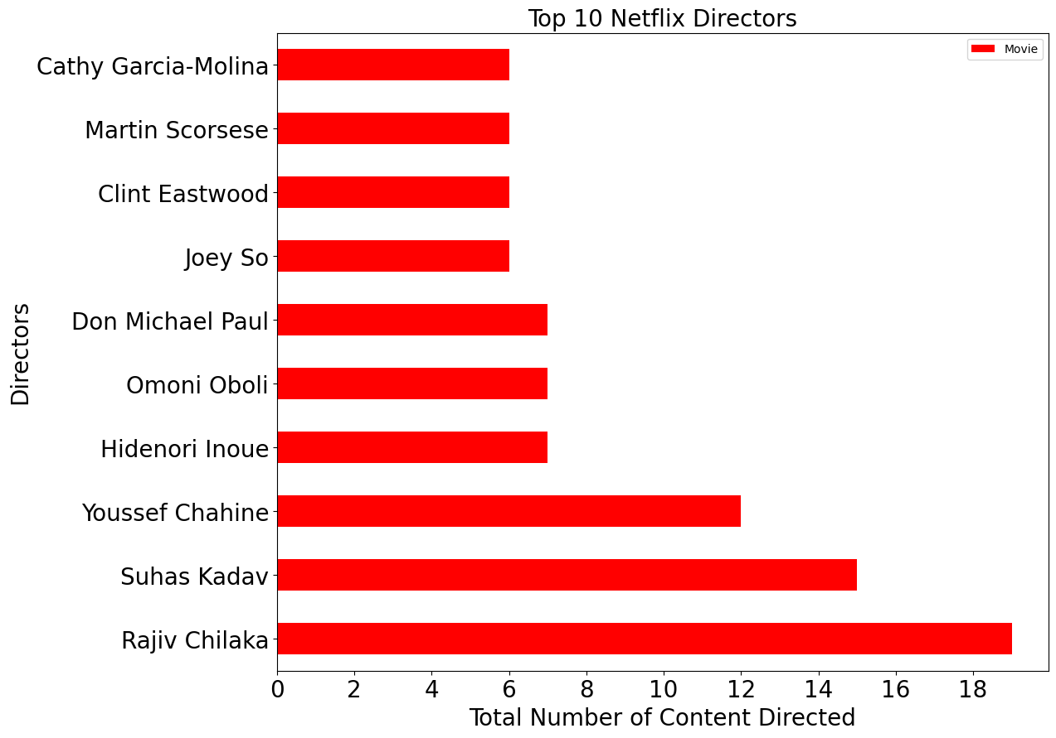
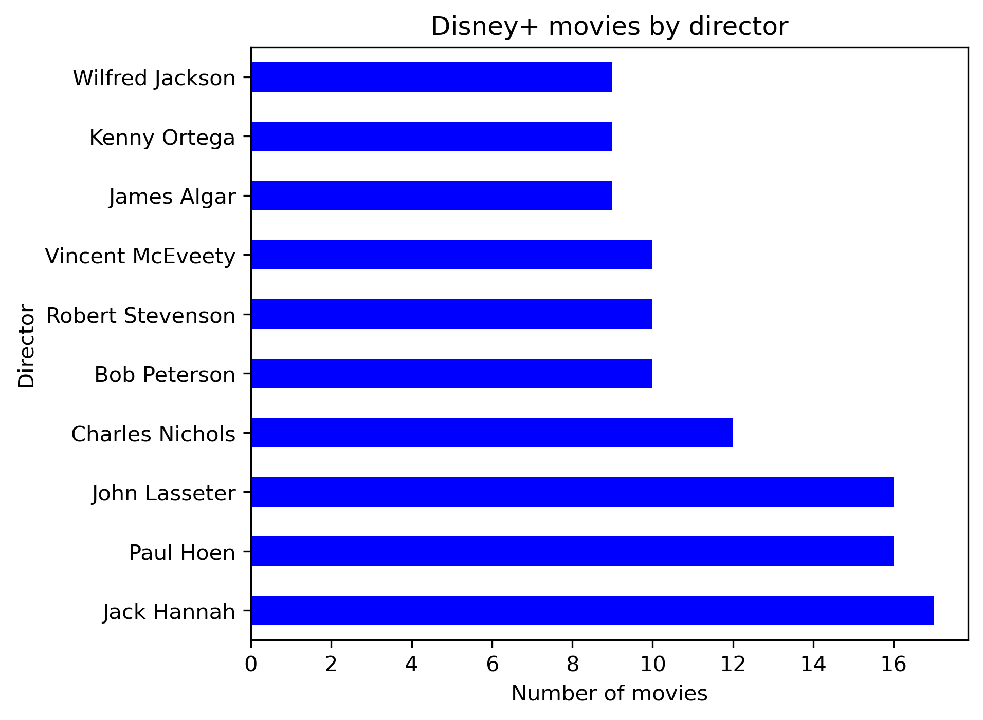
Top 10 directors for Movie
Netflix’s most prolific directors are mostly of Indian nationality.
Most of these directors are animated shorts

Slide 17
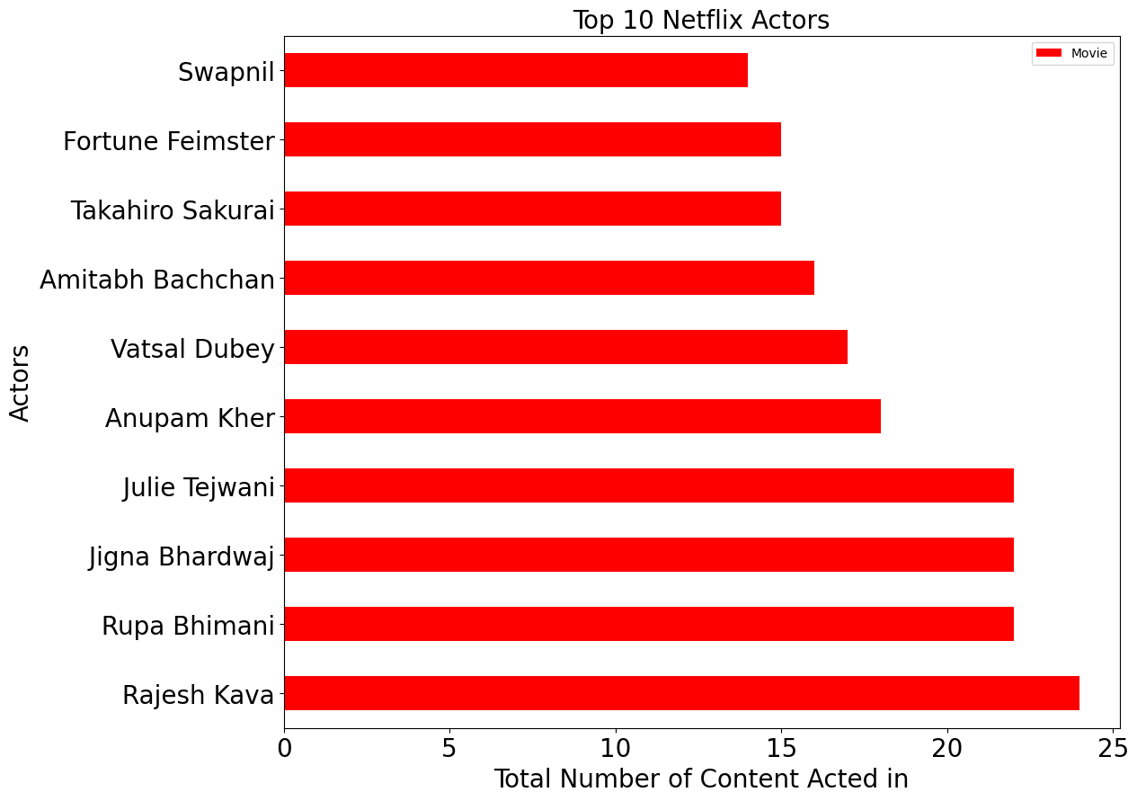
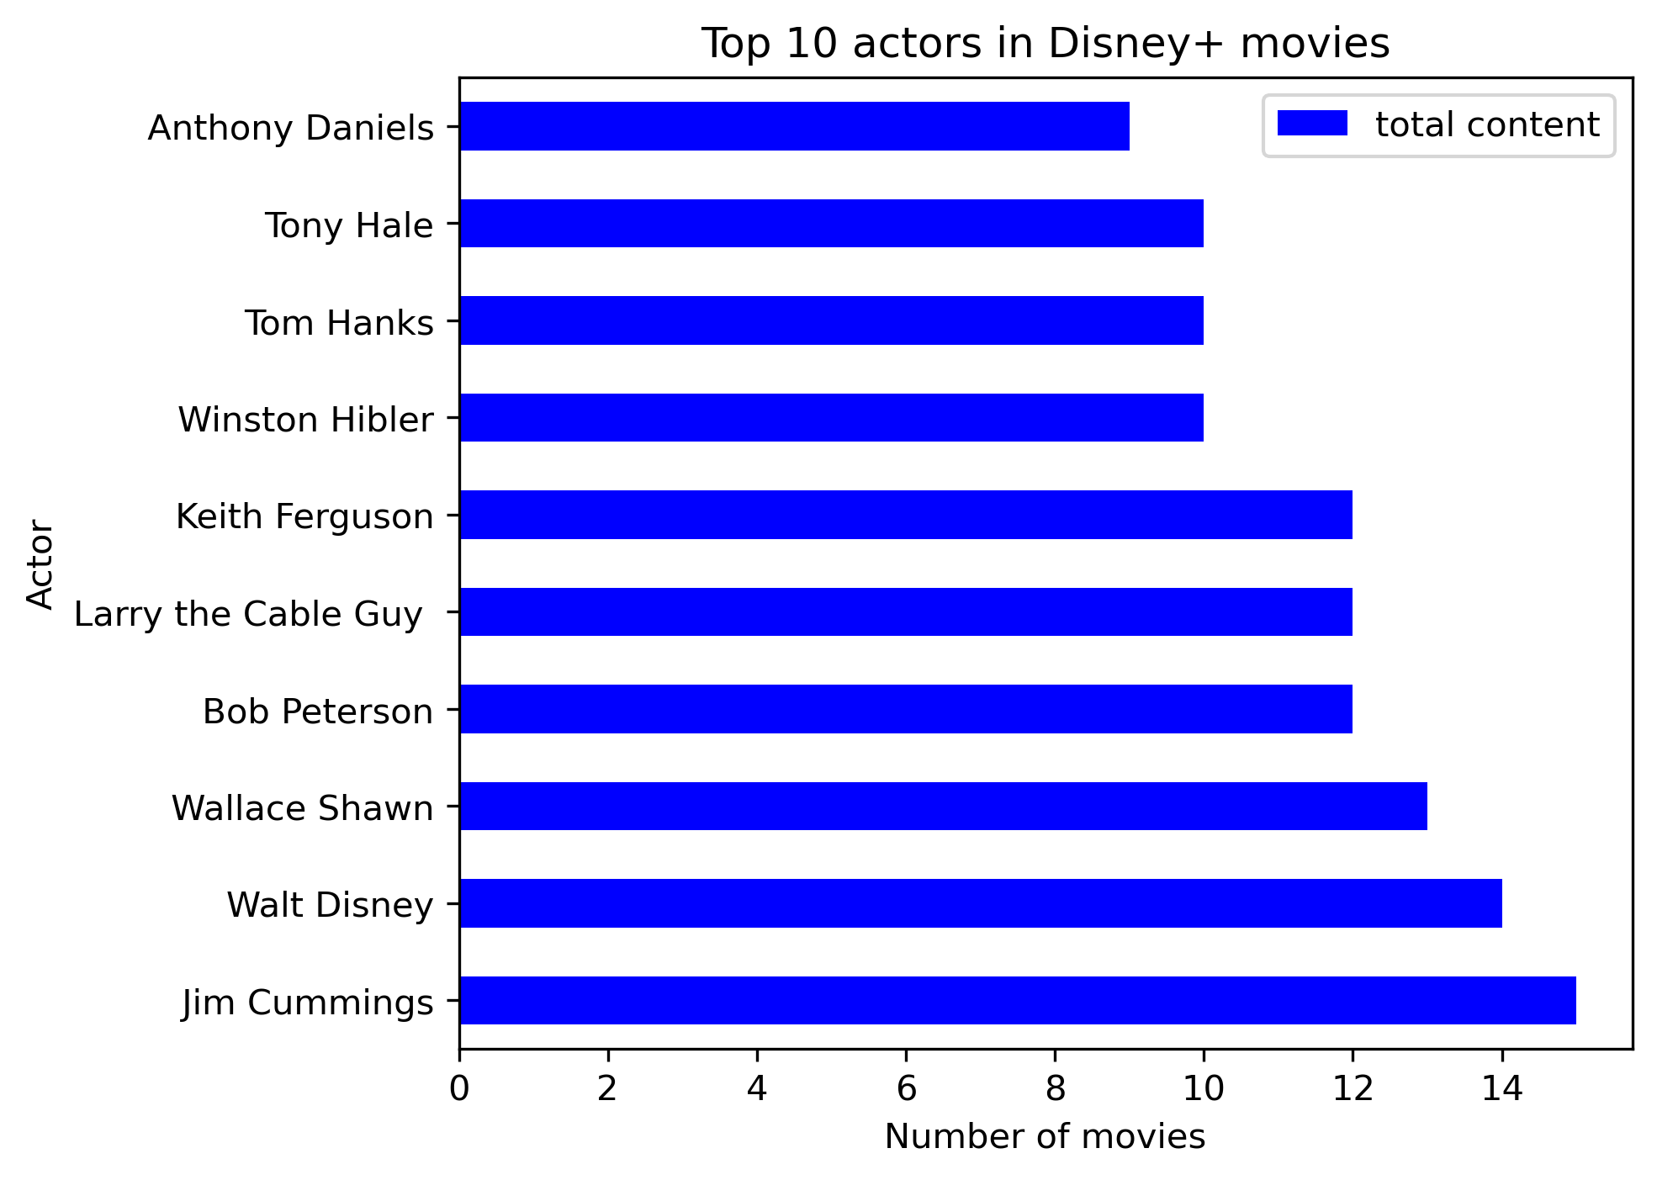
Top 10 actors for Movie
Again most Netflix top actors are of Indian origin
Most of Disney+ most popular actors relates to earlier Walt Disney content

Slide 18
Limitations
04

Slide 19
Limitations
Disney+ data set is much smaller that Netflix, which makes the analysis time frame to be much shorter
Disney+ data set does not have information on directors of TV shows
It would be useful to have the number of viewers for each content
It would also be useful to have more financial data such as subscription fees etc.

Slide 20
Q&A

